Slide 1
Signal Processing
Tirgul 8 – Convolution theorem, filters and spectrogram

Slide 2
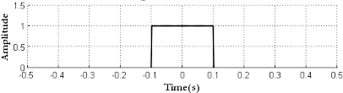
How does the DFT of a rectangle look like?

Slide 3
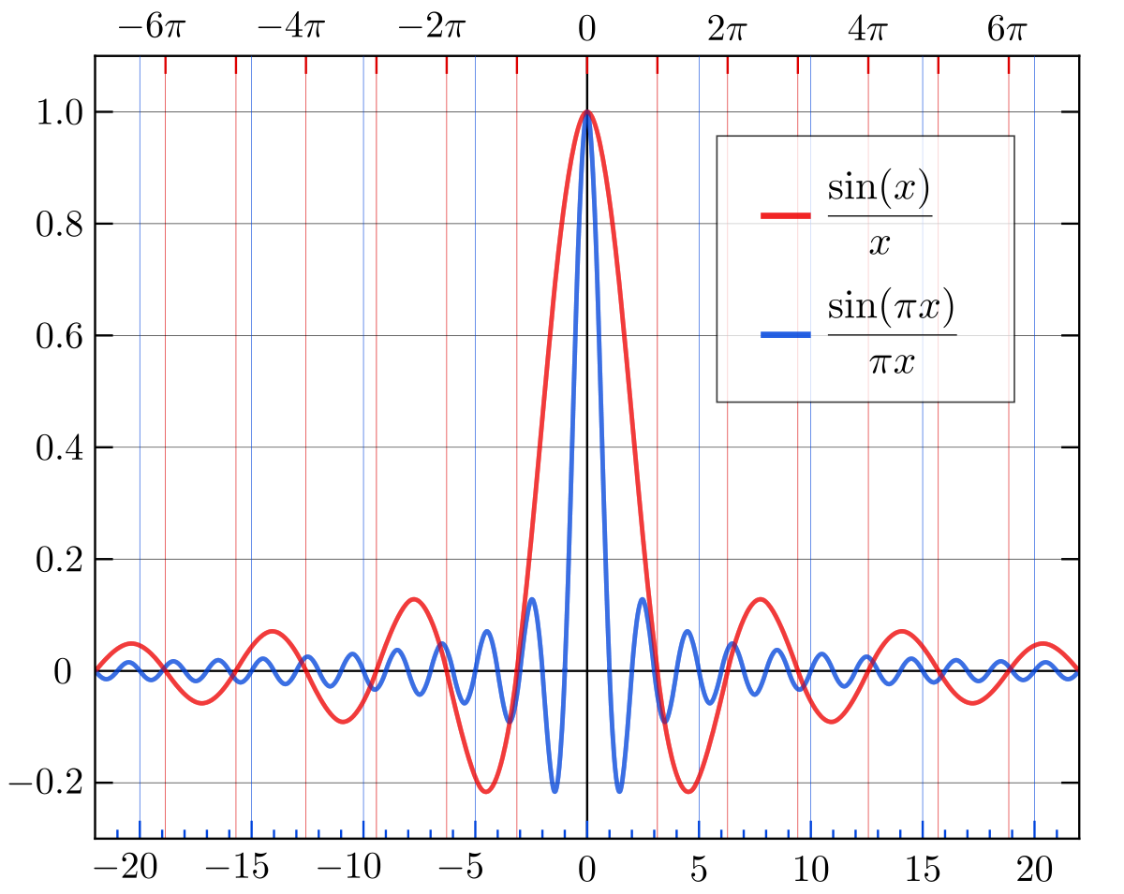
Sinc function
zeros:
every multiplication of pi
every integer

Slide 4
How does the DFT of a gaussian looks like?

Slide 5
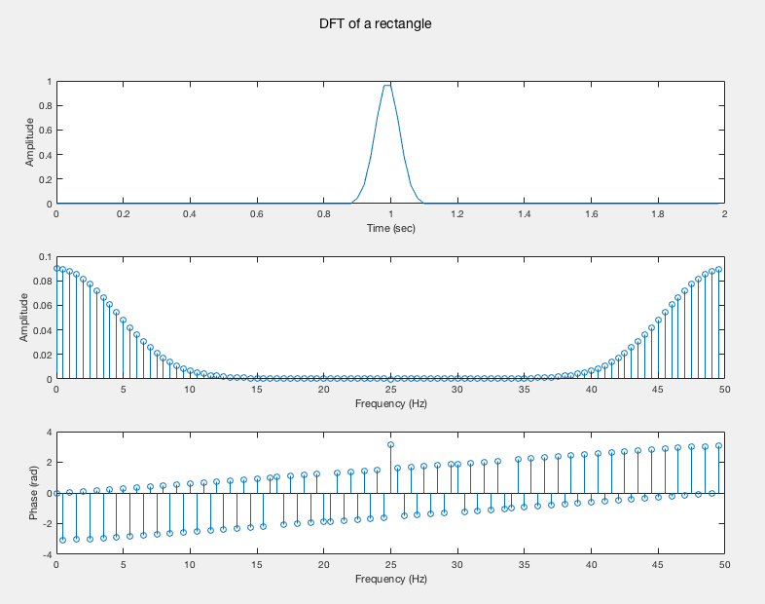
Fourier transform of special functions
Gaussian:

Slide 6
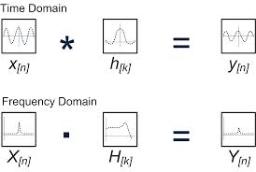
Convolution Theorem
Convolution in the time domain = multiplication in the frequency domain

Slide 7
Example
What will be the DFT result of a convolution between a cosine with a frequency of k and another function with a range of frequencies?
Answer:
According to the convolution theorem, convolution in the time domain equals multiplication in the frequency domain. Therefore, we will multiply a delta function in the k frequency and a range of frequencies with different amplitudes. Since all other frequencies except k reset to zero, we will get still a delta function at the k frequency (the phase and amplitude may be different).
Performing the inverse DFT, we will get only the cosine with a frequency of k.

Slide 8
Code example

Slide 9
Filters

Slide 10
Motivation
Filters are used to eliminate unwanted frequencies from an input signal, or to select a desired frequency range among many others.
We will focus on digital filters.

Slide 11
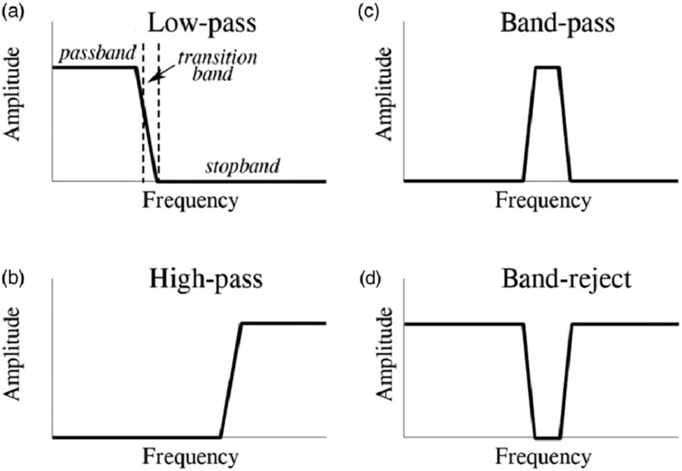
Types of filters
More commonly called ‘band-stop’ or ‘notch filter’ when used for a narrow frequency band (e.g 50Hz)

Slide 12
Constructing a filter
We design the filter in the frequency domain.
Then we perform an inverse DFT on it,
to get the filter coefficients in the time domain.
The obtained filter coefficients can be used
by applying convolution.

Slide 13
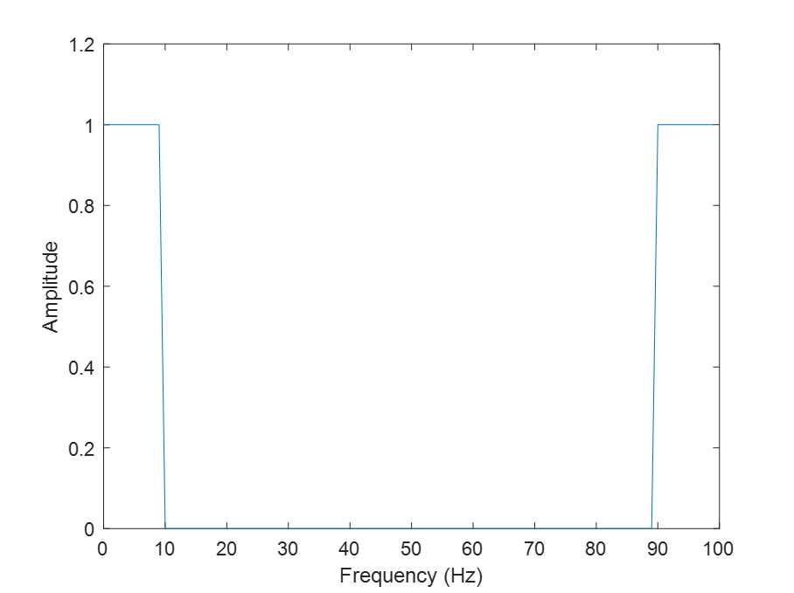
Ideal low pass filter

Slide 14
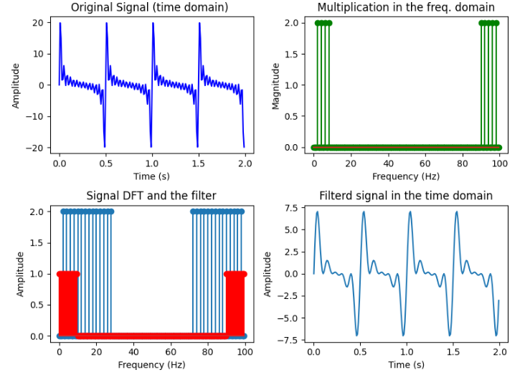
Code example - low pass filter
What happened to the signal?
Convolving the signal with a rectangle removed the higher frequencies of the signal (the signal was ‘filtered’)
We call this removal of high frequencies: ‘low pass filter’

Slide 15
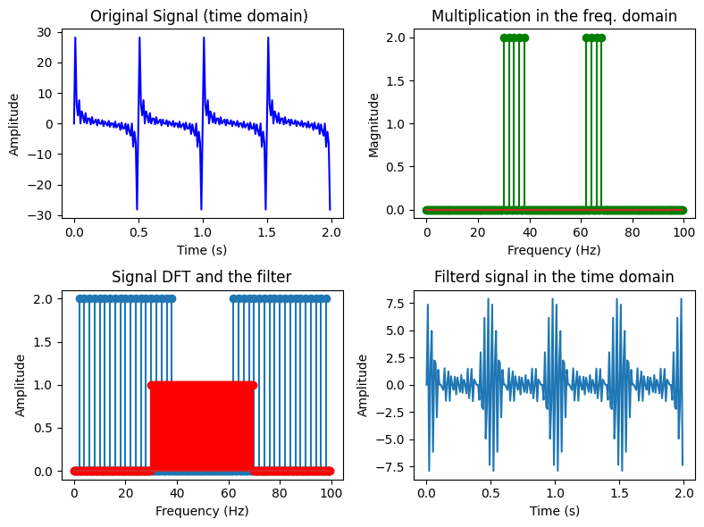
Code example - high pass filter

Slide 16
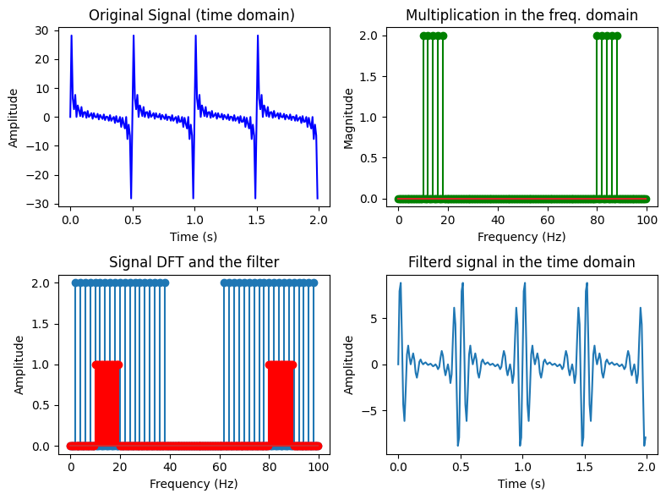
Code example - band pass filter

Slide 17
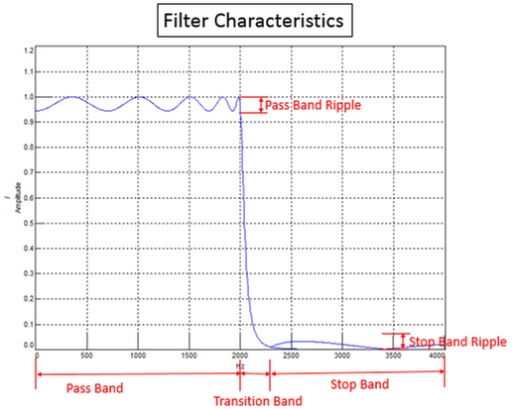
Filter Characteristics

Slide 18
Spectrogram
(short-time fourier transform)

Slide 19
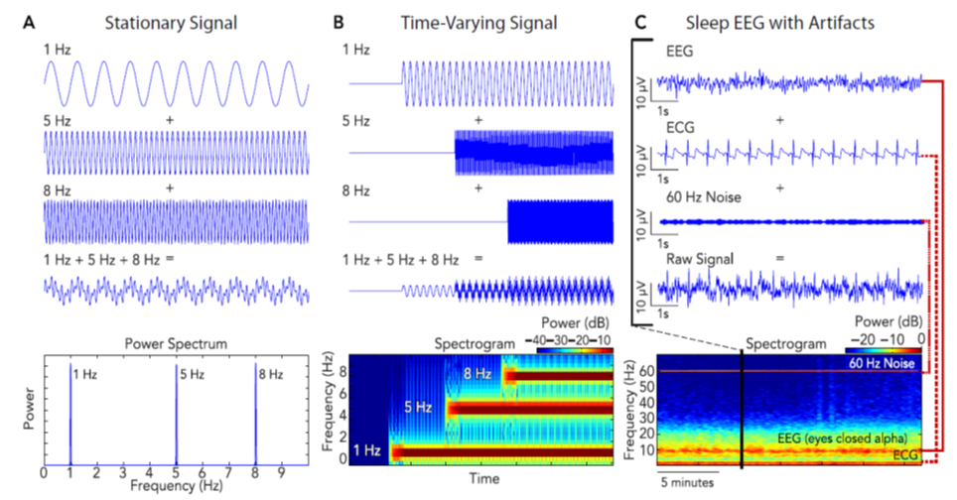
Spectrogram

Slide 20
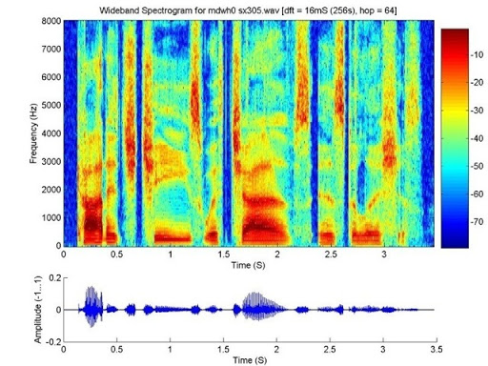
Spectrogram of speech

Slide 21
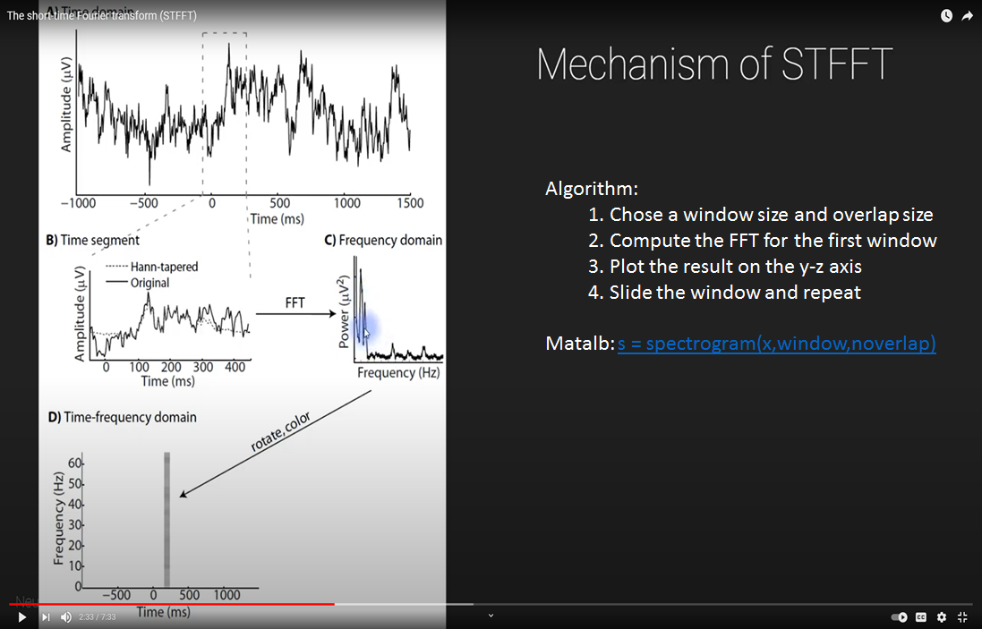
How to compute the spectrogram?
Short-time fourier transform (STFT)

Slide 22
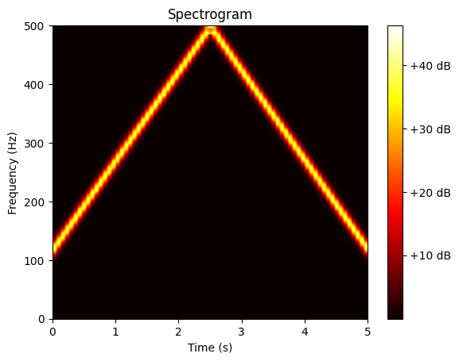
Code example - spectrogram

Slide 23
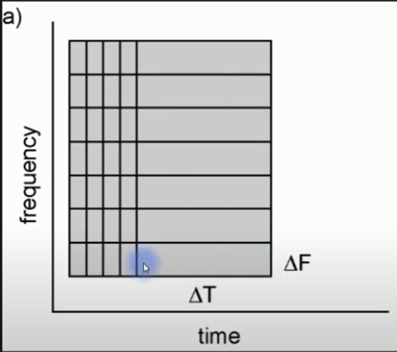
Time-frequency STFT trade-off

Slide 24
If we have time: FIR and IIR filters

Slide 25
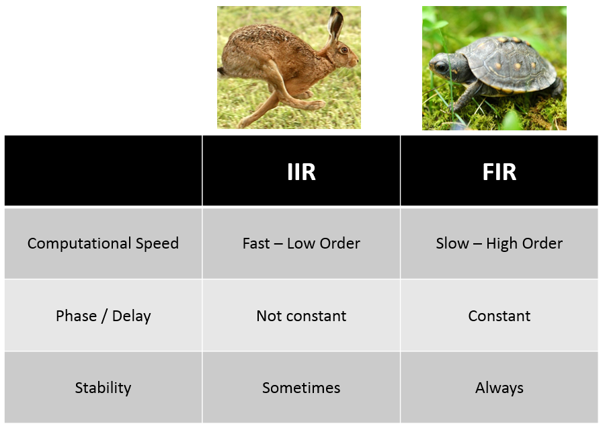
FIR or IIR filters?
Pros:
IIR are more efficient
IIR has a better roll-off transition
IIR has less ripples
Cons:
IIR can diverge
FIR are easy to analyze
FIR preserve phases

Slide 26
Finite Impulse Response (FIR)
Is basically a convolution with some specific kernel
For example, a rectangle, a triangle etc are all FIR filters
The result of the filter is always finite number of non-zero values
This is why it is called finite
The values of the FIR (the coefficients) can be obtained by examining the filter response to an impulse: i.e. the delta function
This is why it is called impulse response

Slide 27
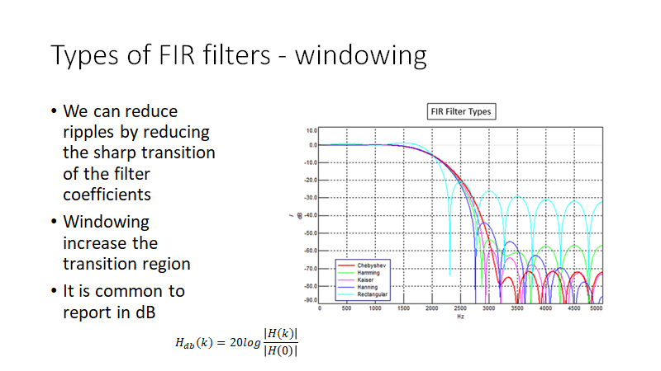

Slide 28
Example of FIR
h(x) = [1 2 3 2 1 ]/9;
This is a smoothing filter which reduce high frequencies
This is also called a 5 tap filter or 5-order filter
To get the values of h (if we don’t know them) we can apply it on an impulse (delta) function
Make sure you understand why this is true by looking at the time and frequency domains
The filter impulse response h.
conv(h,[1 0 0 0 0]) =~ [1 2 3 2 1]/9

Slide 29
Infinite Impulse Response filters (IIR)
Are recursive (use the output of the filter as part of the filter)

Slide 30
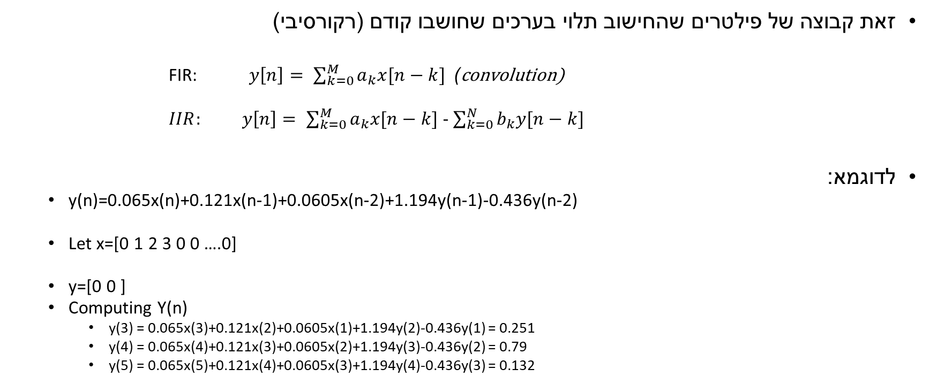
IIR Filters

Slide 31
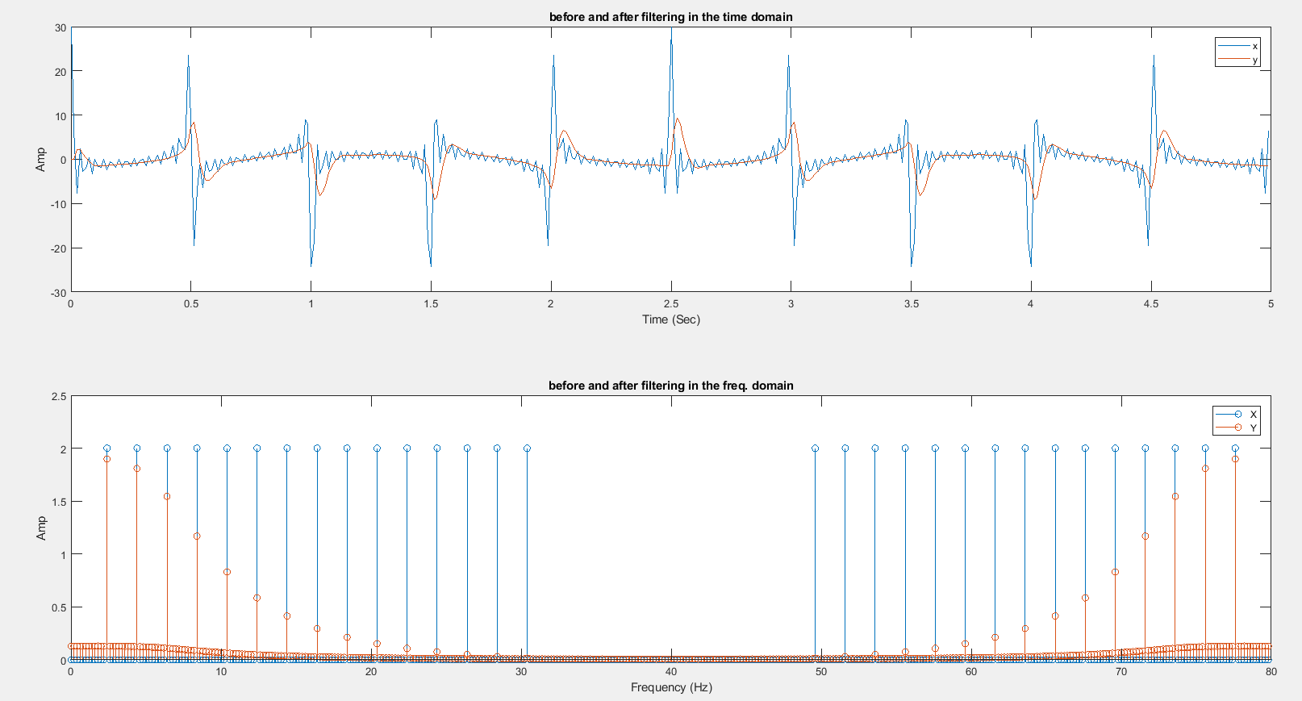
IIR example

Slide 32
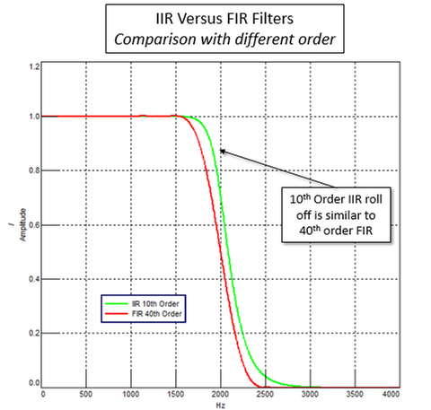
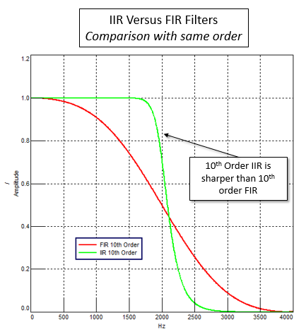
FIR or IIR ?
IIR is faster
IIR is sharper (roll-off)

